Slide 1
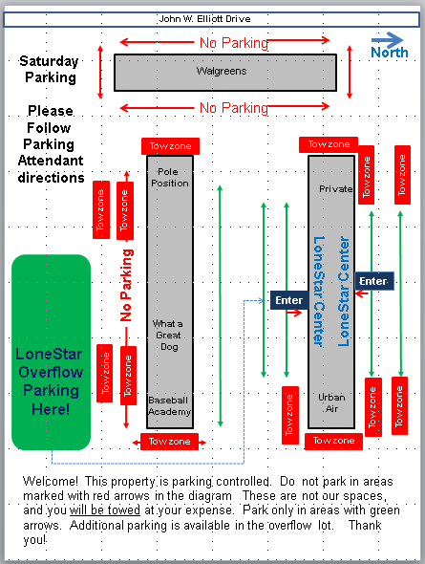
Monday-Saturday Parking Map
Sunday Parking Map
Walgreens
Walgreens
Tow Zone Until 7:00p
Open Parking
Volleyball
Enter HERE
Follow Attendants
NO
Volleyball Entry
Volleyball
Enter HERE
Follow Attendants
NO
Volleyball Entry
Tow Zone
Tow Zone
Open
Tow Zone Until 7:00p
Open Parking
2
3
2
3
1
1
LoneStar Volleyball Overflow Parking
Cart Service to LoneStar Available Weekends
LoneStar Volleyball Overflow Parking
Cart Service to LoneStar Available Weekends
Tow Zone 24x7
Tow Zone 24x7
Tow Zone
Tow Zone

